Slide 1

STREET DOG ADOPTION SITE
Paws for a moment and discover a lifelong friend on the streets – their journey may lead them to your heart.

Slide 2
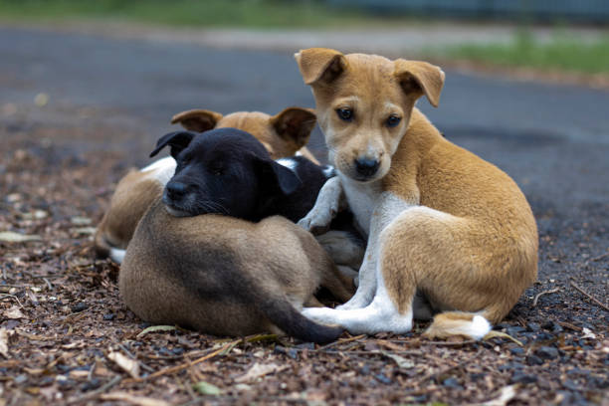

Team-4
Batch of 2021-2024
SHREYAL UMREDKAR(201021468003)
MEDUM UHITHA(201021468004)
BASANI VARSHITHA(201021468014)

Slide 3
ABOUT THE PROJECT
Welcome to the Street Dog Adoption Center, where we are dedicated to finding loving homes for street dogs in need. Our organization is committed to making a positive impact on the lives of street dogs and the communities they inhabit. Through our comprehensive adoption platform and unwavering dedication, we strive to create a world where every dog has a chance at a happy and fulfilling life.
At the Street Dog Adoption Center, our mission is simple: to rescue, rehabilitate, and rehome street dogs in need. We believe that every dog deserves a loving home, regardless of their background or circumstances. By providing a safe and nurturing environment for street dogs, we aim to give them a second chance at life and a brighter future.

Slide 4
What Sets Us Apart:
Comprehensive Adoption Platform: Our website features a user-friendly interface, an adoption form, and a listing of available dogs, making it easy for potential adopters to find their perfect match.
Educational Resources: We provide informative content and a comprehensive FAQ section to raise awareness about street dog adoption and address common questions and concerns.
Dedicated Team: Our team is comprised of passionate individuals who are committed to the welfare of street dogs. From rescue and rehabilitation to adoption and beyond, we are here every step of the way to support our furry friends and their new families.
Donation and support:Whether you're looking to adopt, volunteer, or donate, there are many ways to get involved with the Street Dog Adoption Center. Together, we can make a difference and give street dogs the love and care they deserve. Join us in our mission to create a world where every dog has a place to call home.

Slide 5
Frontend Technologies:
HTML (HyperText Markup Language): HTML will be used to structure the content of our web pages, including text, images, and other elements.
CSS (Cascading Style Sheets): CSS will be used to style and format the HTML content, ensuring a visually appealing and consistent design across the website.
JavaScript (JS): JavaScript will add interactivity and dynamic functionality to our web pages, such as form validation, interactive elements, and AJAX requests.
Backend Technologies:
PHP (Hypertext Preprocessor): PHP will serve as the server-side scripting language for handling form submissions, interacting with the database, and processing user authentication.
MySQL: MySQL will be used as the relational database management system (RDBMS) to store user data, dog details, and other application information.
JavaScript (Node.js): Node.js will be used as the backend runtime environment to execute JavaScript code on the server side, enabling server-side scripting and handling of HTTP requests.

Slide 6
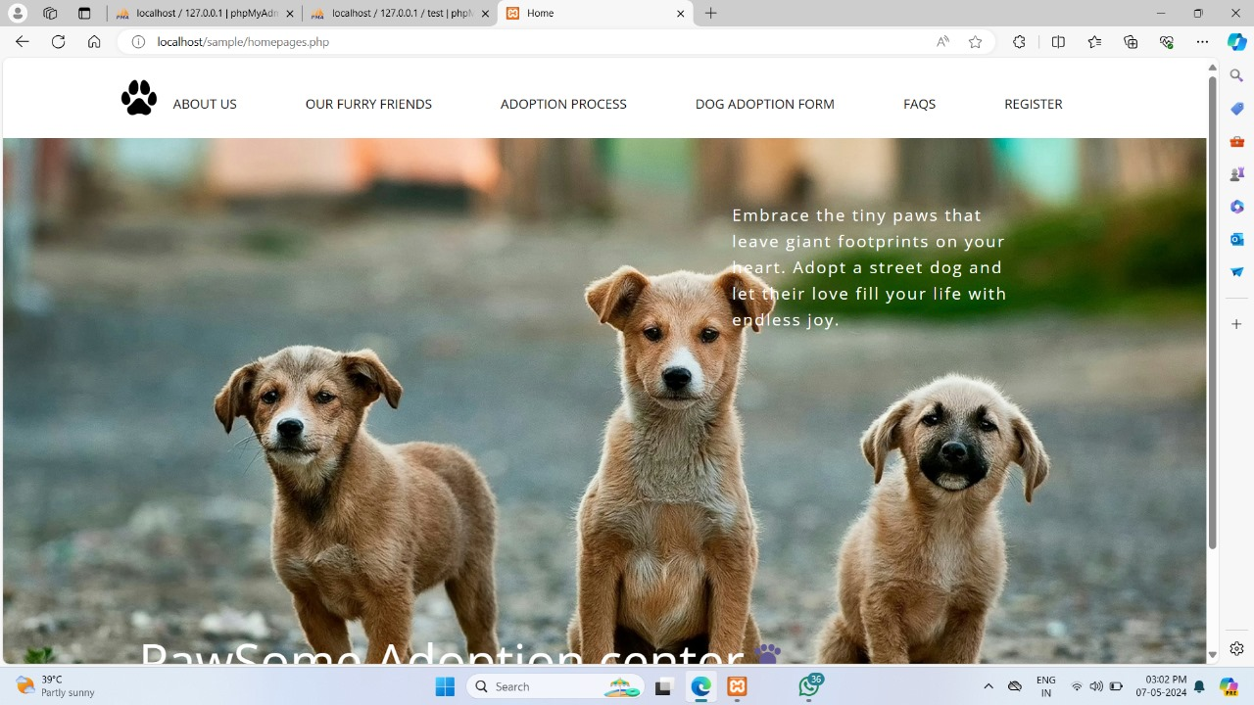
Home Page

Slide 7
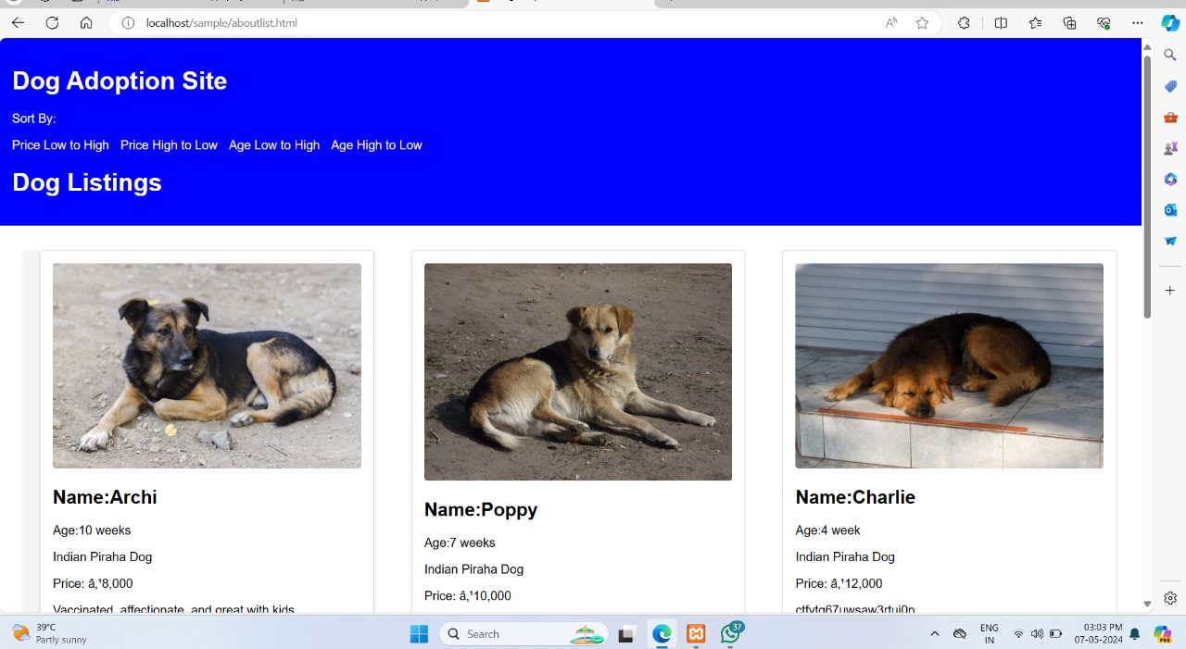
Dog Listing:

Slide 8
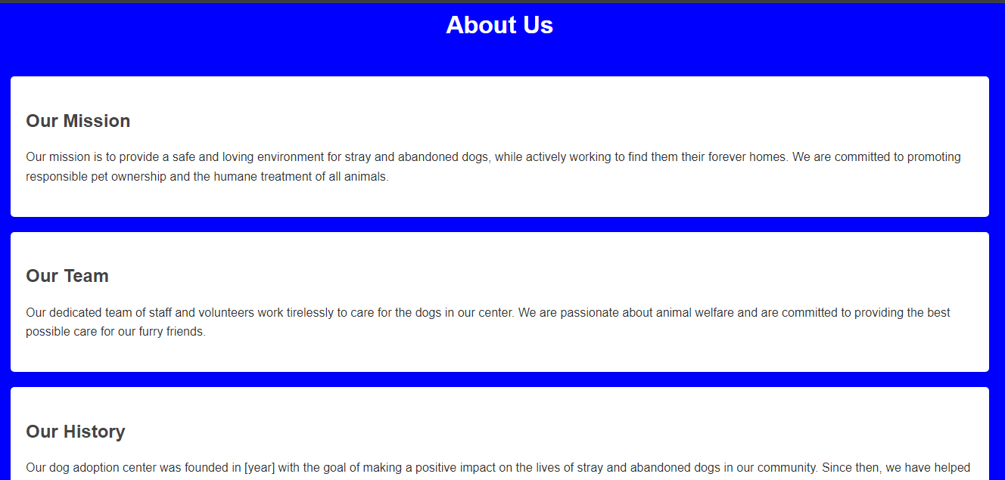
About Us

Slide 9
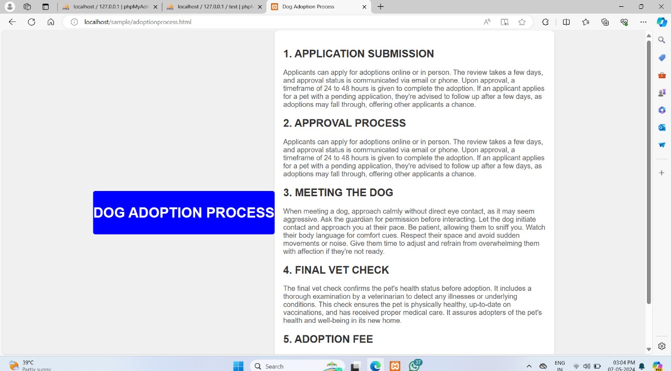
Adoption process

Slide 10
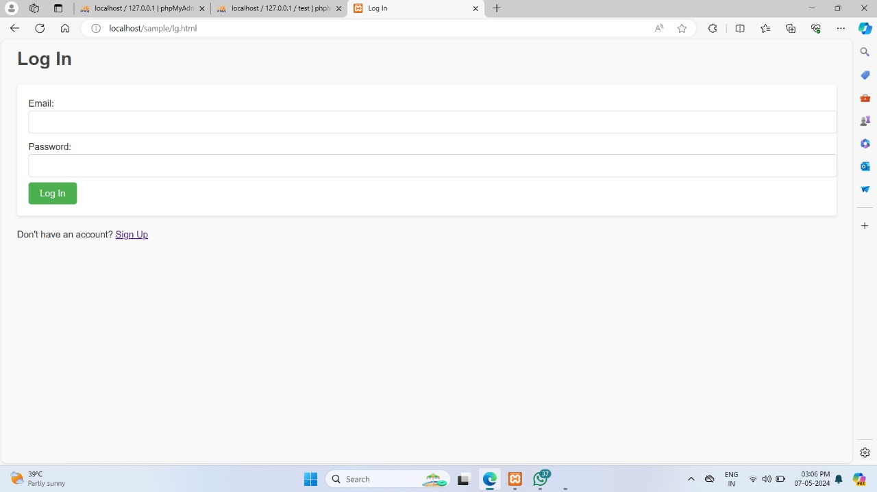
Sign in:

Slide 11
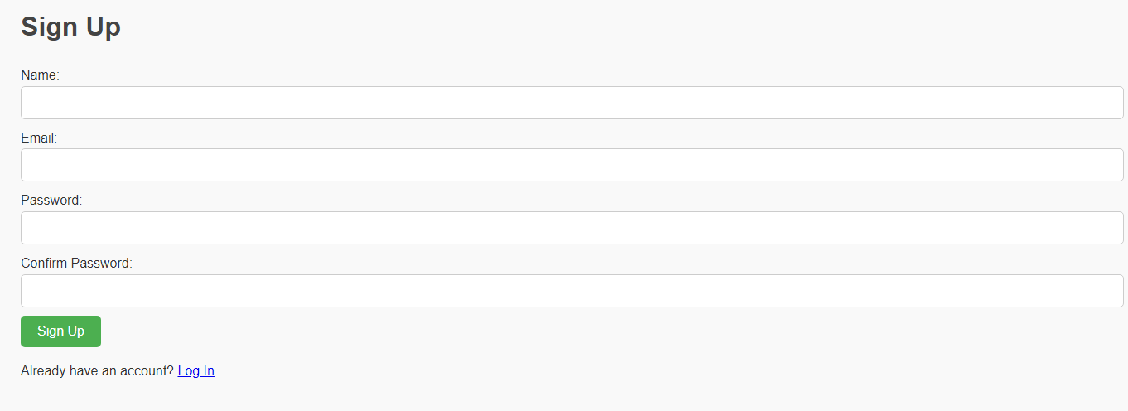
Sign Up:

Slide 12
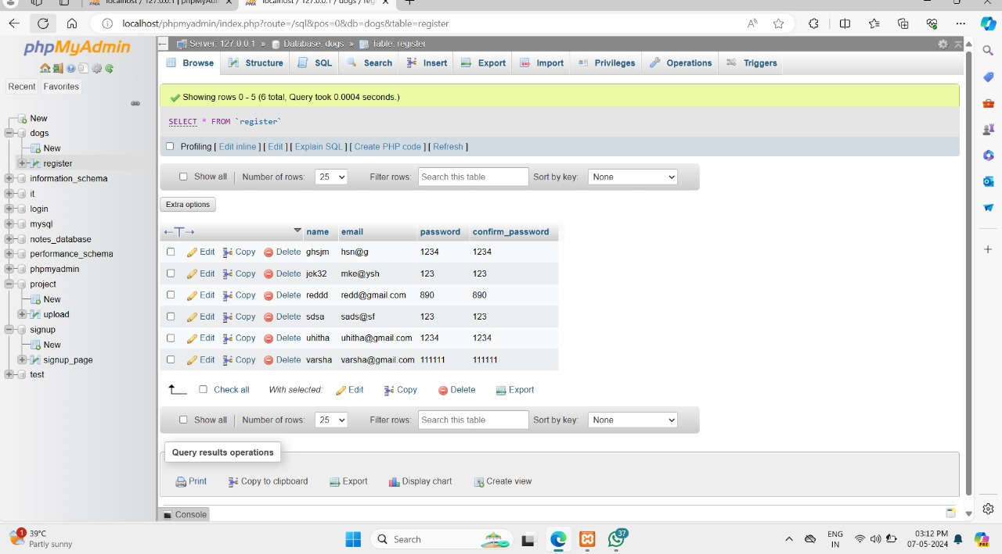
Database Collection:

Slide 13
Conclusion:
In conclusion, the Street Dog Adoption Center website serves as a beacon of hope and compassion for street dogs in need of loving homes. Through a combination of frontend and backend technologies, we have created a user-friendly platform that facilitates the adoption process, raises awareness about street dog adoption, and fosters a sense of community among adopters and supporters.
From the homepage to the adoption form, FAQ section, dog listing page, and about us page, every aspect of the website is designed to provide a seamless and enriching experience for visitors. Our mission to rescue, rehabilitate, and rehome street dogs is reflected in every element of the website, from the informative content to the dedicated team behind the scenes.
As we strive to make a positive impact on the lives of street dogs and the communities they inhabit, we invite you to join us in our mission. Whether you're looking to adopt, volunteer, or donate, there are many ways to get involved and make a difference. Together, we can create a world where every dog has a chance at a happy and fulfilling life.
Thank you for visiting the Street Dog Adoption Center website. Your support means the world to us, and together, we can change lives, one adoption at a time.

Slide 14
Thanking You

